Slide 1
To-Do List
Ifan Clarke

Slide 2
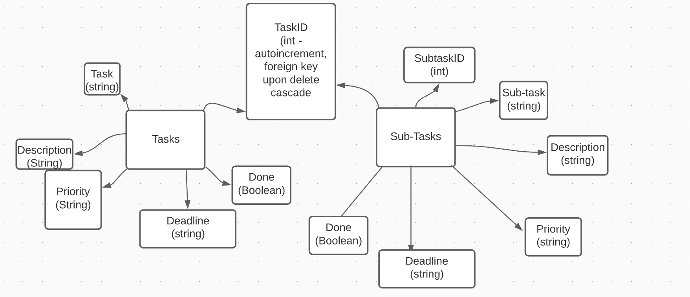
Concept

Slide 3
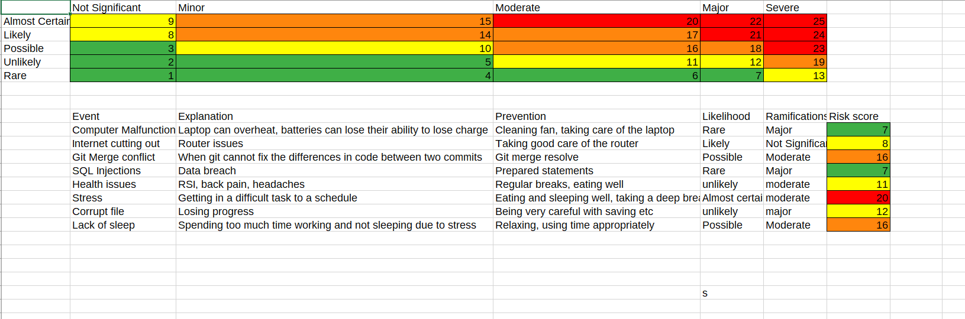
Concept

Slide 4
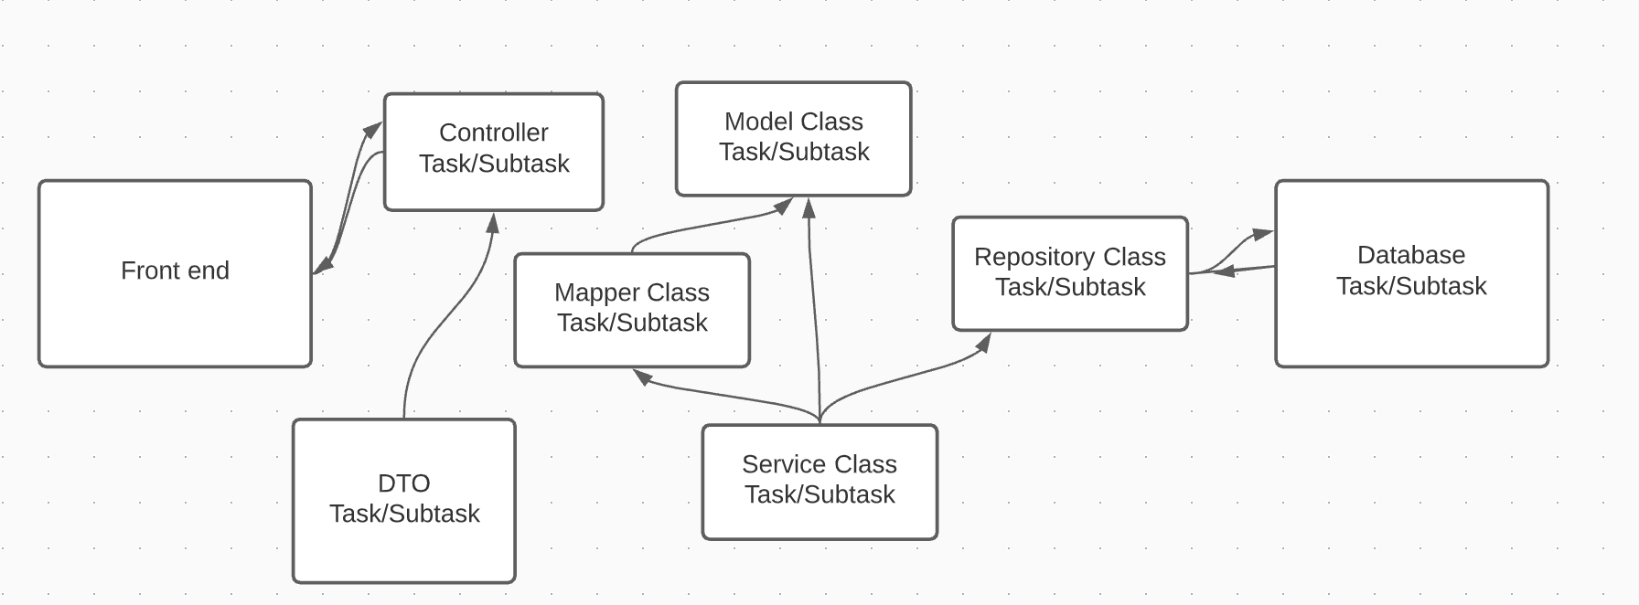
Concept

Slide 5
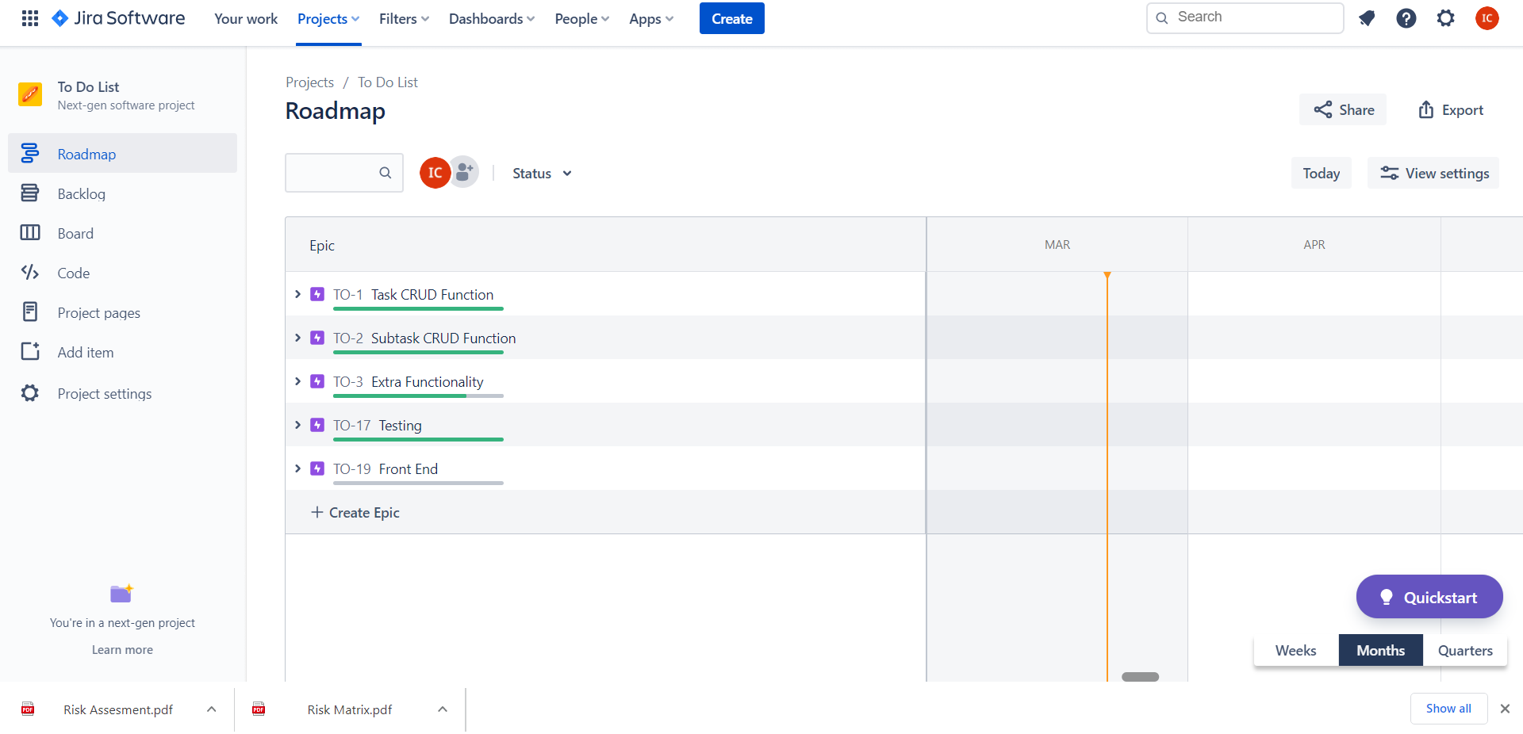
Jira

Slide 6
Consultant Journey - Technologies
Spring Boot, HTML, CSS, JavaScript, Mockito, J-Unit

Slide 7
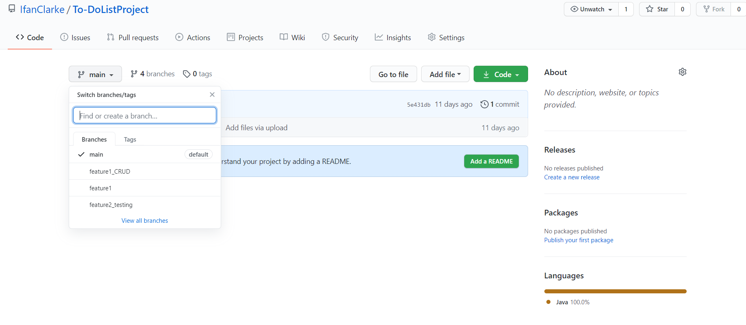
Git and GitHub

Slide 8
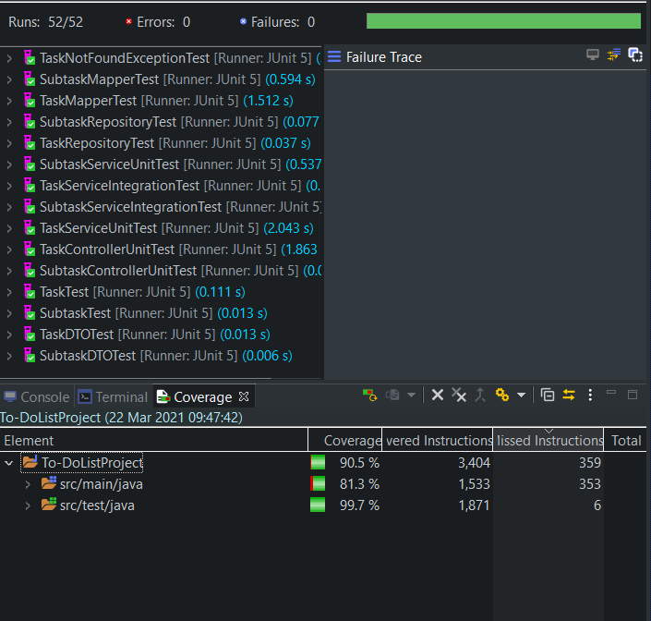
Testing

Slide 9
Demo

Slide 10
Conclusion

Slide 11
Q & A

